Slide 1

CHAPTER 8
Report Writing
DISCOVER . LEARN . EMPOWER

Slide 2
INDEX
Types of report
Structure and components of scientific
Different steps in the preparation,
Layout, structure and Language of typical reports,
Illustrations and tables
Bibliography, referencing
Footnotes

Slide 3
RESEARCH REPORT
A research paper/report is a systematic write up on the findings of the study including methodologies, discussion, conclusions etc. following a definite style.
More elaborately and precisely, a report or systematic write up on the findings of a research study including an abstract/executive summary/summary, introduction, methodology/materials and methods, results and discussion, conclusions and recommendations, references etc. following a definite style or format may be called a Research Report.

Slide 4
TYPES OF REPORT
Informational
Analytical
Persuasive

Slide 5
COMPONENTS OF A RESEARCH REPORT
Beginning Material: Title page, abstract, key word list, table of contents, list of figures and tables, acknowledgements
Chapter 1: Introduction – statement of the problem, hypotheses, why it is important, objectives of the work, scope of the work
Chapter 2: Background and Literature Review – discuss related work and indicate how it relates to report
Chapter 3: Procedure – describe the procedure used in project, data used, and how it was obtained
Chapter 4: Results – indicate what happened and interpret what it means
Chapter 5: Conclusions and Recommendations – summarize conclusions and what they mean (i.e., answer the question, “So what?”). What changes and further work do you recommend?

Slide 6
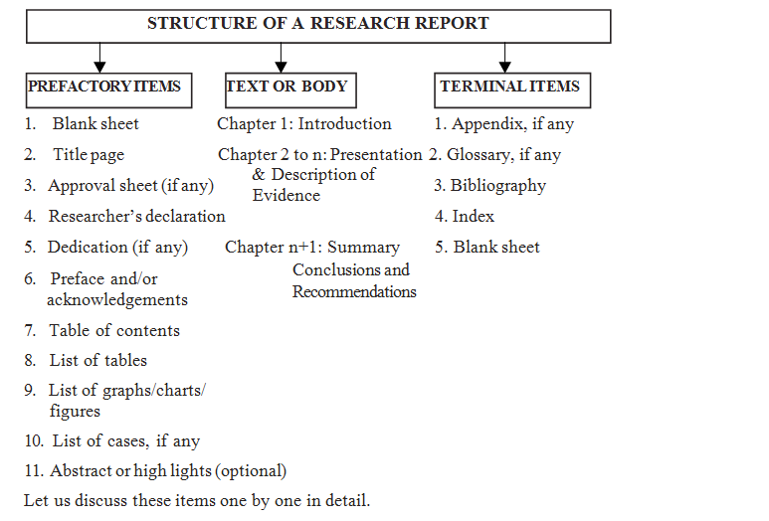
STRUCTURE OF THE RESEARCH REPORT

Slide 7
Different steps in the preparation
Research reports are the product of slow and painstaking and accurate work. Therefore, the preparation of the report may be viewed in the following major stages.
1) The logical understanding and analysis of the subject matter.
2) Planning/designing the final outline of the report.
3) Write up/preparation of rough draft.
4) Polishing/finalization of the Report.

Slide 8
Language of typical reports
Clarity: Use clear and concise language. Avoid unnecessary jargon.
Formality: Reports are generally written in a formal tone, but the level of formality can vary based on the audience and purpose.
Accuracy: Ensure accuracy in data presentation and language use.
Objectivity: Maintain an objective tone, avoiding personal opinions unless specified.
Consistency: Be consistent in your writing style, formatting, and use of terminology.
Conciseness: Avoid unnecessary details and focus on conveying essential information.
Professionalism: Use professional language and formatting appropriate for the context and audience.
Visual Aids: Incorporate visuals like graphs, tables, and charts to enhance understanding.

Slide 9
Tables
Tables placed in the results section of the paper are reserved for the most important data directly related to the experiment. Tables are economical in that they compress data and allow the reader to see relationships not otherwise discernible at a glance.
A good table should not duplicate the text of the RESULTS but the text should highlight the data by referring to the table.
The table should be self explanatory as well as related to the text.
Always number the tables and refer to those numbers in the text - If tables are included in an APPENDIX, these are identified with capital letters (e.g., Table A).
Tables always appear in the order in which they are mentioned in the text.
Every table is given a brief explanatory title written in telegraphic style. It is placed below the table number and above the table.
Enough space is used to render the table easily readable. Notes of sub-headings are employed to explain abbreviations, parentheses or units of measurement.

Slide 10
Illustrations
What has been said of Tables applies generally to the figures of the results section as well.
Figures are graphs, charts, and illustrations.
The caption is placed below the figure instead of above. The word ‘Figure 1’ appears first followed by the caption. Only the first word of the caption is capitalized.
If there is enough space, you may place it on the same page as text, but a separate page should otherwise be used, especially for publishing purposes.
Remember to place the dependent variable on the vertical axis and to follow the rules for correct calibration of the data.
Both axes should be clearly labeled, and the graph lines too when appropriate.

Slide 11
Bibliography
Positioning of the Bibliography: The bibliography comes after the appendices section and is separated from it by a division sheet written BIBLIOGRAPHY.
It is listed as a major section in all capital letters in the table of contents.
A bibliography contains the source of every reference cited in the footnote and any other relevant works that the author has consulted.
It gives the reader an idea of the literature available on the subject that has influenced or aided the author.

Slide 12
Bibliography
Bibliographical Information: The following information must be given for each bibliographical reference.
Books Magazines and Newspapers
1) Author(s) 1) Author(s)
2) Title (underlined) 2) Title of the article (Within quotation marks)
3) Place of publication 3) Title of the magazine (underlined)
4) Publisher 4) Volume number (Roman numerals)
5) Date of publication 5) Serial number (Arabic numerals)
6) Date of issue

Slide 13
Referencing
This is the last section and it should conform to APA style.
Centre the word ‘REFERENCES’ at the top of the page, but do NOT underline it or place it in quotation marks.
A reference list cites works that are publicly available.
This section is always placed on a separate page, and the page number is omitted.
Works cited in the text of your experiment must appear in the reference list and conversely each entry in the reference list must be cited in your text.
Since reference lists are intended for the use of the reader, they must be accurate and complete.
A reference consists of the following broad subsections - AUTHOR, DATE OF PUBLICATION, TITLE and PUBLICATION DATA.

Slide 14
Footnotes
Footnotes are rarely used in psychology.
They may be used to acknowledge a research grant or assistance of others in preparation of a study.
Avoid footnotes.
Sometimes you want to say something that isn’t quite necessary.
This is the time to use a footnote. If you can get away without using them, it saves the reader’s eyes.
But sometimes it’s hard to resist making rather extensive, but rather tangential remarks.
These go in footnotes, not the text.
The really eager reader will read them. Others will not.

